Slide 1
American Christian Music
Bellman Fellowship 3/12/2010

Slide 2
What is Christian Music?
Music that glorifies God?
Music about Christianity?
Music that talks about Christians?
Music played by Christians?
Music sang by Christians?
Music created by Christians?
Music created for Christians?

Slide 3
Christian Music
Psalms (before Christ)
Chant
Classical Music
Hymn
Gospel
Praise and Worship
Contemporary Christian Music

Slide 4
Hymns
“A hymn is the praise of God with song; a song is the exultation of the mind dwelling on eternal things, bursting forth in the voice.” --- Thomas Aquinas (12th Century)
Martin Luther (16th Century)
A Mighty Fortress Is Our God
http://www.youtube.com/watch?v=-Y-_TsRjm5Y

Slide 5
American Hymnody
19th Century saw a new wave of hymn-writing: expressing one's personal feelings in the relationship with God in simple worship style
along with the Second Great Awakening in America led to a new style called gospel, and a new explosion of sacred music writing with Fanny Crosby, Lina Sandell, Philip Bliss, Ira D. Sankey, and others who produced testimonial music for revivals, camp meetings, and evangelistic crusades.

Slide 6
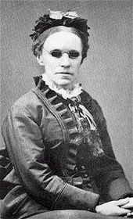
Fanny Crosby
One of the most prolific hymnists in history, writing over 8,000 despite being blind since infancy.
"Blessed Assurance", "Praise Him, Praise Him", and "To God Be the Glory"

Slide 7
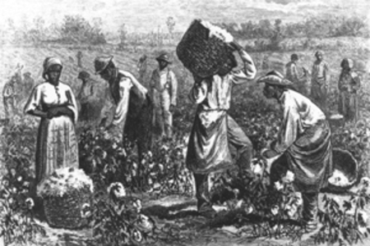
Spirituals
Developed during times of slavery to express their faith and hope.
http://www.youtube.com/watch?v=nCg_XS2Yrs4
Swing Low Sweet
Swing low, sweet chariot, Comin' for to carry me home; Swing low, sweet chariot, Comin' for to carry me home.
I looked over Jordan, And what did I see, Comin' for to carry me home, A band of angels comin' after me, Comin' for to carry me home.

Slide 8
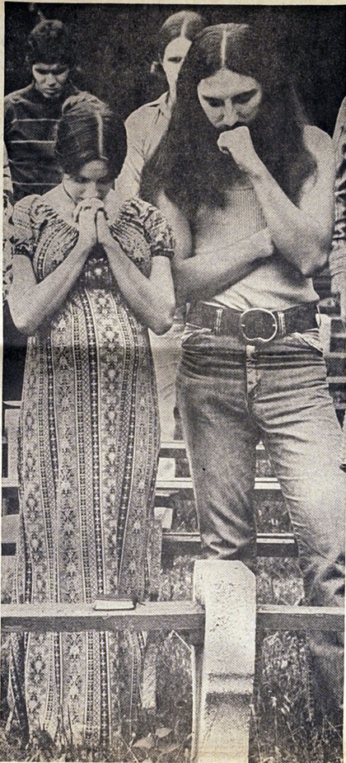
Jesus Movement
In the late 1960s and early 1970s and spreading primarily through North America and Europe. It was the major Christian element within the hippie counterculture, or, conversely, the major hippie element within some strands of Protestantism. Members of the movement were called Jesus people, or Jesus freaks.

Slide 9
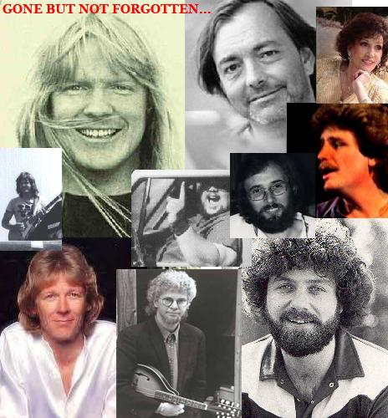
Jesus Music
Large numbers of hippies and street musicians began converting to born-again Christianity.
These musicians continued playing the same styles of music that they had been playing prior to their conversion, though they now infused their lyrics with a Christian message.

Slide 10
Until Your Love Broke Through
Like a foolish dreamer, trying to build a highway to the sky All my hopes would come tumbling down, and I never knew just why Until today, when you pulled away the clouds that hung like curtains on my eyes Well I've been blind all these wasted years and I thought I was so wise But then you took me by surprise Like waking up from the longest dream, how real it seemed Until your love broke through I've been lost in a fantasy, that blinded me Until your love broke through All my life I've been searching for that crazy missing part And with one touch, you just rolled away the stone that held my heart And now I see that the answer was as easy, as just asking you in And I am so sure I could never doubt your gentle touch again It's like the power of the wind Like waking up from the longest dream, how real it seemed Until your love broke through I've been lost in a fantasy, that blinded me Until your love, until your love, broke through
http://www.youtube.com/watch?v=uJIjRWFU4jM http://www.youtube.com/watch?v=h89-3_kIRDA

Slide 11
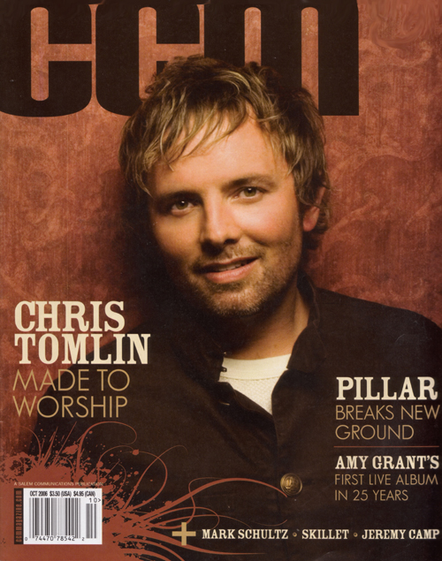
CCM Magazine Christian Music Industrialized
The first edition of CCM Magazine was published in July, 1977. By 1976, it was apparent that a new generation of performers who had grown up in the church wanted to play non-secular pop and rock music for other Christians. By the end of the 1970s the term "Jesus music" fell out of use as the movement was replaced by the industry

Slide 12
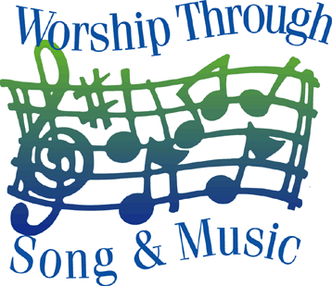
Contemporary Christian Music
Instrumental
Bluegrass gospel
Acapella
Christian Country
Urban Gospel
Southern Gospel
Praise & Worship

Slide 13
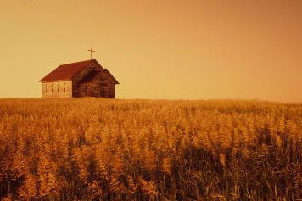
Christian Country
http://www.youtube.com/watch?v=XjEpB2ikkuE

Slide 14
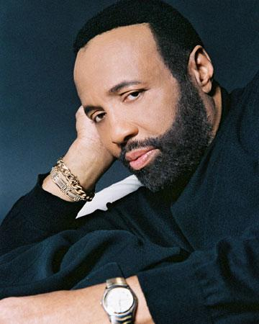
Urban Gospel
Andraé Crouch
Jesus is the Answer for the World Today
Through it All
Soon and Very Soon
My Tribute
http://www.youtube.com/watch?v=lmGiu9JfbIs
Shirley Caesar
The Winan’s
…

Slide 15
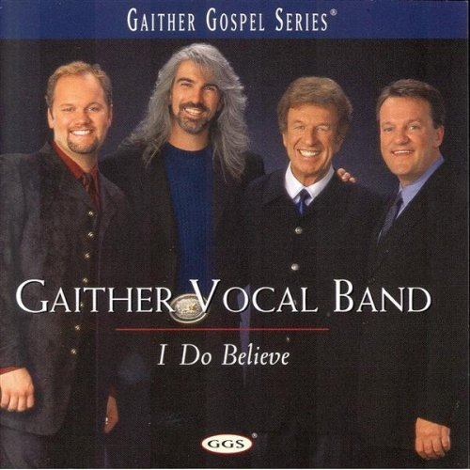
Southern Gospel
Sometimes marketed as Quartet music
http://www.youtube.com/watch?v=rlZgJoA3-ao
Gaither Homecoming

Slide 16
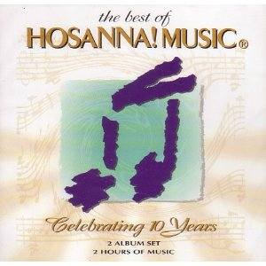
Praise & Worship
Maranatha! Music
Vineyard
Integrity Music
Passion
Hillsong
Worship Leaders/Song Writers
Don Moen, Ron Kenoly, Bob Fitts, Paul Baloche, Lenny LeBlanc, Martin Nystrom, Darlene Zschech, Matt Redman

Slide 17
Some Popular Worship Songs in the 90’s
Ancient of Days
http://www.youtube.com/watch?v=UOe5GpqFJrE
I worship You Almighty God
http://www.youtube.com/watch?v=ElJ4MDaVEdA
There is None Like You
http://www.youtube.com/watch?v=CwETNyWzD3w
Contemporary praise & worship goes international

Slide 18
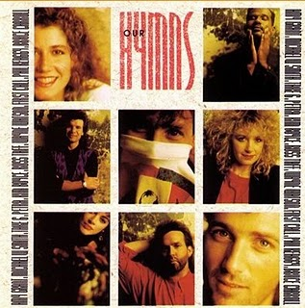
Christian Contemporary – Inspirational
Amy Grant
Steve Green
Steven Curtis Chapman
Sandi Patti
Michael W Smith
Wayne Watson
Russ Taff

Slide 19
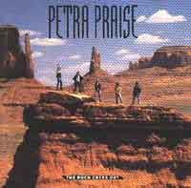
Christian Rock
Petra – One of the pioneers in Christian Rock
Phil Keaggy – One of the best guitar masters in the world
DC Talk – Most popular group in the 90’s
Third Day – Rock group remain true to their calling
Christian Rock and Festivals

Slide 20
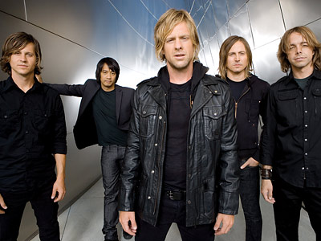
Christian Artists “Crossovers”
U2 (started off with heavy Christian influence)
Amy Grant
Mercy Me
Lifehouse
Switchfoot
Flyleaf
Huge market
Grammy Awards
Simply artists who are Christians
Soft
Hard

Slide 21
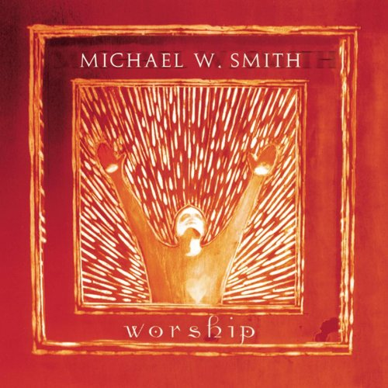
Back to Worship
Artists with focus on Worship Music
Sonic Flood
Delirious
Chris Tomlin
David Crowder Band
Michael W. Smith
Jeremy Camp

Slide 22
What is Christian Music?
Should we listen to these music?
How do we discern?
Can Christians write other music?
Make good use of music, don’t let it use you
Use suitable songs to worship
Use suitable songs for your listening pleasures
Use suitable songs to practice your music skills

